Slide 1
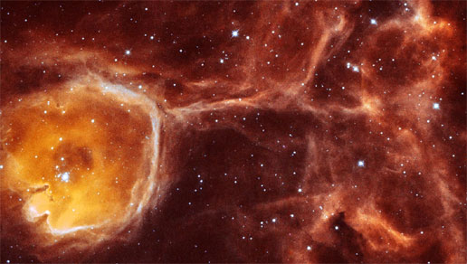
Stellar Winds and Mass Loss in the Late Stages of Stellar Evolution
Nicholas M. Hunt-Walker
UCA SPS – Mar 2015

Slide 2
Progression
Motivations
Basic Definitions
Dust-driven Winds
Line-driven Winds
Relation to My Work
Acknowledgments
Notes:
Start with why studying stellar winds is important to astronomy
Introduce some basic definitions for going forward in the talk
Talk about dust-driven winds in cool stars
Talk about line-driven winds in hot stars
Connect it to my work
Acknowledge people who helped

Slide 3
What Won’t be Discussed
Very low mass stars (M* < 0.8 M⊙)
Mass loss on the Main Sequence
Supernovae
Planetary Nebulae
Mass transfer in multi-star systems
Notes:
Winds from very low mass stars – haven’t evolved away from their hydrogen-fusing phase yet. Takes longer than the current known age of the universe, so they don’t yet have late stages
The Main sequence is the primary phase of a star’s life time, not the late stages. So, even though there are winds here, they’re not relevant to this discussion.
Supernovae occur after a high mass star has ended its nuclear fusion life. At that point, it’s no longer a star.
Similarly, PNe occur after a low-mass star has ended its fusion life.
Mass transfer in multi-star systems has a lot to do with the companion stars, and I want to just focus on the winds.
Motivations next

Slide 4
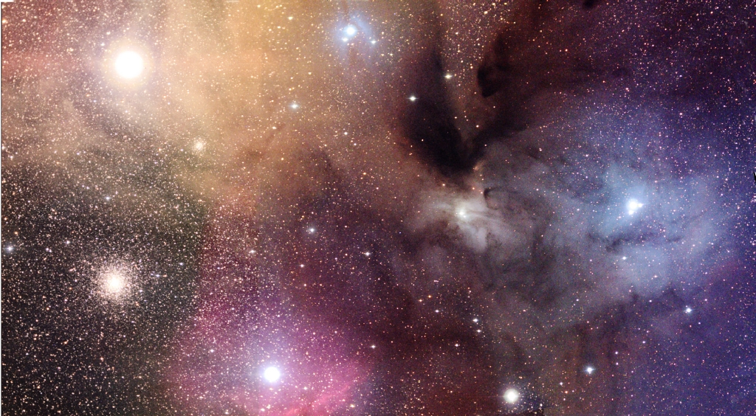
Motivations
Gas (red, yellow, blue) and dust (dark clouds) in the ISM near Rho Ophiuchi;
Credit: NOAO
Notes:
A large motivation is for studies of the interstellar medium, or ISM, shown here as the colored gas and dark splotchy dust amongst the stars.
Enriching the ISM next

Slide 5
Motivations: Enrich and Encourage New Stars
Winds expel elements forged in stars (via fusion, s-process, etc)
Elements in winds seed the gas and dust between stars in the Milky Way (the ISM)
Radiation pressure from winds churn local ISM, encouraging star birth
Enriched ISM produces new stars with higher elemental content
Notes:
Winds expel elements forged in stars into their surroundings
These elements then seed gas and dust in the ISM once the ISM is reached
Radiation pressure from winds also physically moves the gas and dust around
Moving the chemically-enriched gas and dust around increases the likelihood that it’ll form stars
Eagle nebula next

Slide 6
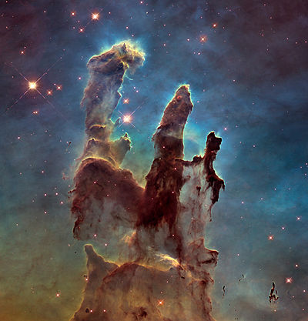
Motivations: Enrich and Encourage New Stars
The Pillars of Creation, Eagle Nebula
Hubble Space Telescope
Notes:
Here’s an example of a stellar nursery, the Pillars of Creation in the eagle nebula. Even though all of the stars in this image appear red (and therefore cool), they’re actually blue stars that have had their blue light absorbed or scattered by gas and dust. Their winds shape and enrich this nebula.
LMC and Matsuura next.

Slide 7
Motivations: Enrich Galaxies
Winds replenish overall dust/gas budget of galaxies
In the LMC winds from evolved cool stars return:
5.5-11.5 x 10⁻⁵ M⊙ yr⁻¹ in dust
11-23 x 10⁻³ M⊙ yr⁻¹ in gas (Matsuura et al 2009)
The LMC in IR
Matsuura et al 2009
Notes:
The ISM is ubiquitous throughout galaxies that are actively forming stars, and the ISM is enriched by winds from stars. So it stands to follow that studying winds from stars will aid in studying galaxies on the full scale. As an example, we have the LMC here, where Matsuura et al 2009 found that winds from evolved cool stars (with clusters being neglected) contributed 5.5-11.5 x 10⁻⁵ solar masses per year in dust, and about 200x more in gas.
Galaxy-scale next

Slide 8
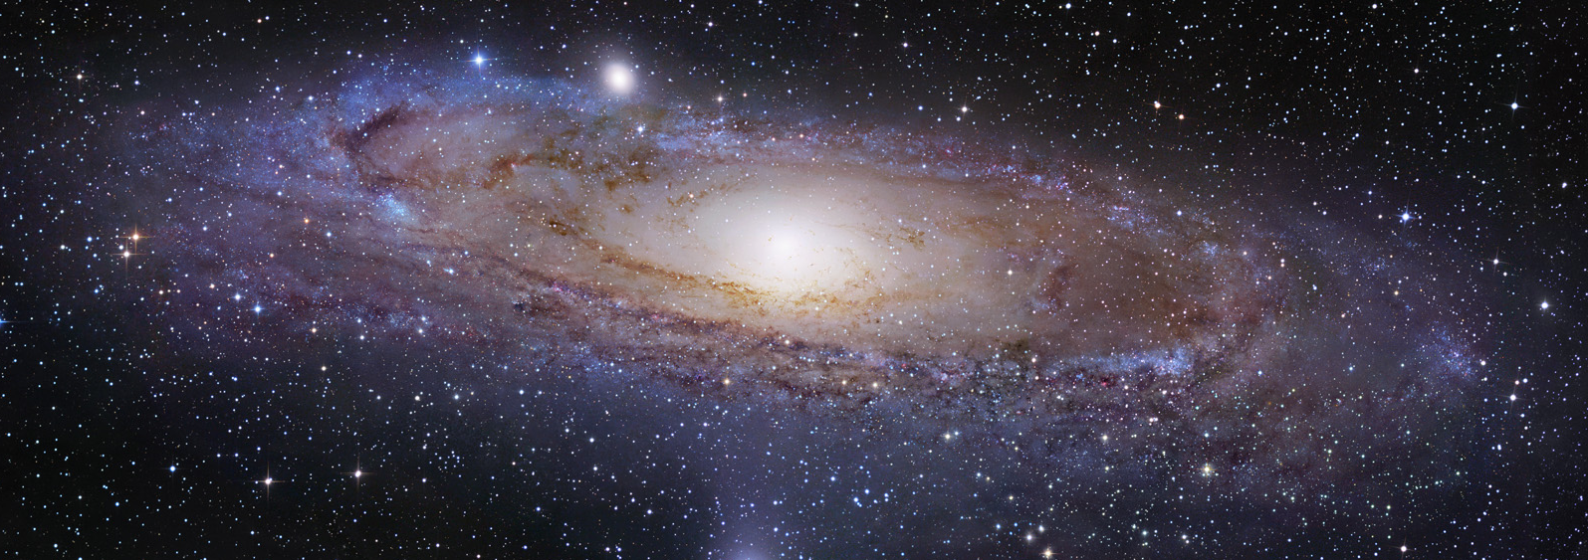
Motivations: Characterize Galaxies
Andromeda Galaxy
Credit: http://apod.nasa.gov/apod/ap140730.html
Notes:
Winds from these stars also help to characterize the structure of galaxies. Shown here is a prime example of a disk galaxy—Andromeda. We believe our galaxy looks a lot like this, and we flesh out that image by looking at the chemical enrichment in our galaxy’s stars.
Metallicity map next.

Slide 9
Motivations: Characterize Galaxies
Chemical enrichment can track structure of the Galaxy (Ivezic et al 2008)
Vertical Distance from Galactic Disk
Horizontal Distance from Galactic Center
Notes:
In Ivezic et al 2008, measurements of chemical abundance were used to not only characterize the structure of the galaxy, but identify parts of our galaxy that aren’t native to the Milky Way like the Monoceros stream. We expect a smooth gradient of chemical enrichment throughout the galaxy, and deviations from that points to something more.
Definitions next

Slide 10
Basic Definitions
Beta decay (e⁺) – the conversion of a neutron into a proton by the emission of a positron (e⁺)
Doppler shift – the apparent shift in the wavelength of light with motion of the emitter or observer; redshift if moving away, blueshift if moving toward
Metal – any element more massive than helium (He)
Metallicity – the measured abundance of a metal in a star’s atmosphere
Nucleosynthesis – the creation of atomic nuclei
Luminosity – amount of energy emitted from star per second;
Notes:
Beta decay aka positron emission – the conversion of a neutron into a proton in the nucleus of an atom, results in the emission of a positively-charged electron. Occurs in unstable atomic nuclei
Doppler shift: the apparent shift in the wavelength of light with motion of the source or the viewer. Redshift if motion away, blueshift toward.
A metal in astronomy is any element on the periodic table more massive than He. For example, Carbon is considered a metal.
Metallicity is the measured abundance of a given metal in a star’s atmosphere. It’s usually given as a measurement with respect to hydrogen abundance, and compared to what’s seen in the Sun.
Nucleosynthesis is the process of creating atomic nuclei by some means. We’ll go over a couple later.
Luminosity is basically the brightness of a star, and is controlled chiefly by the star’s size and temperature. To a smaller degree, it’s also proportional to a star’s metal content
Intro to stellar winds next

Slide 11
Stellar Winds and Mass Loss
Dust-driven winds from high (> 10 M⊙) and low-mass (< 10 M⊙) cool stars
Line-driven Winds from high-mass, hot stars
Notes:
Now that we’ve gotten the basic definitions out of the way, let’s dive head first into Stellar Winds and Mass Loss. We’ll begin with some dust-driven winds that are seen from cool stars of both high and low mass
HR diagram next

Slide 12
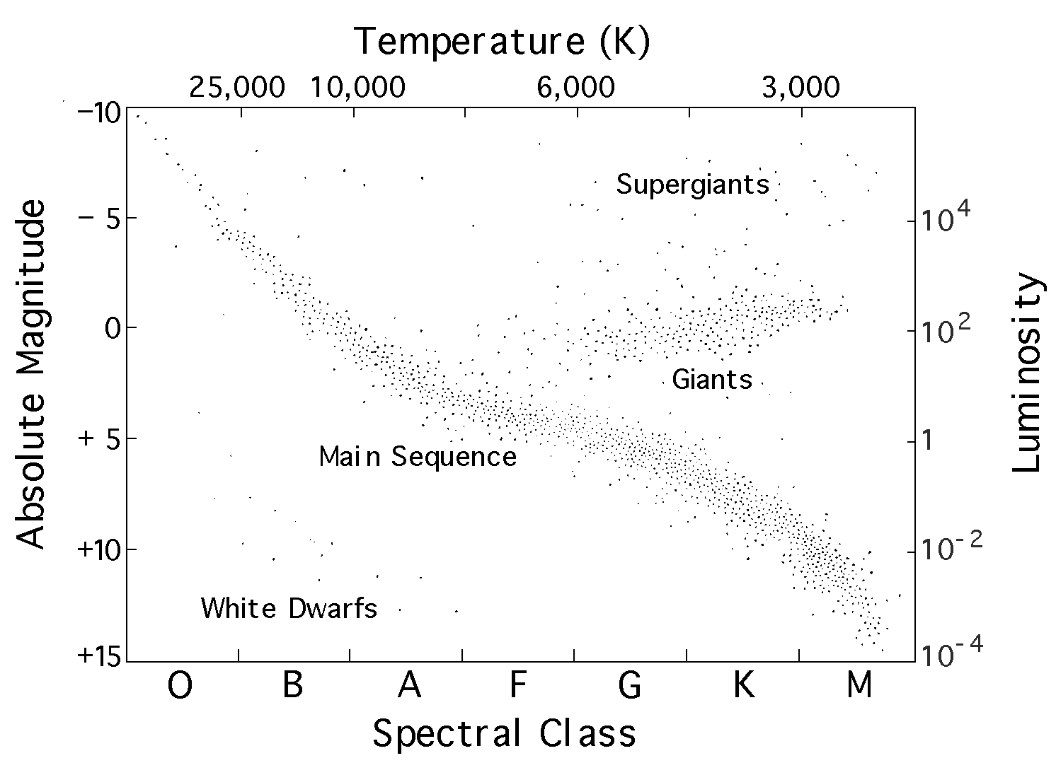
Stellar Winds and Mass Loss
Credit: http://vnatsci.ltu.edu/s_schneider/astro/wbstla2k/mytalk/solar0.shtml
Notes:
Just for some context on these high mass and low-mass stars, I have here a temperature/luminosity diagram.
Right on the Main Sequence is where I’ve placed our Sun for reference. Above that is the regime where evolved stars lie.
For stars hotter than 25,000 K, we have our high-mass end. This is the family of stars that has line-driven winds take place.
On the cool end, we have the regime of evolved low-mass stars, and even some evolved high mass stars. They’ll both be going through some degree of dust-driven wind in this range.
Dust driven winds next.

Slide 13
Dust-driven Winds: Dust
“Dust”: carbon- (C) and oxygen- (O) rich conglomerates of molecules
Dust grains have sizes < 0.2µm
Al
H
C
C
O
O
Acetylene (C₂H₂)
Al
O
Aluminum Oxide (Al₂O₃)
O
O
Si
Anthracene (C₁₄H₁₀);
a polycyclic aromatic
hydrocarbon (PAH)
Silica (SiO₂)
Lamers & Cassinelli 1999; Waters 2011; Karovicova et al 2013
Notes:
Note that the molecule on the bottom left side is an example of a PAH, or a polyaromatic hydrocarbon. It’s another way of saying large chains of carbon rings bonded to hydrogen atoms. Every corner here is a hydrogen atom.
These individual molecules become dust grains when attracted to each other in dust clouds by intermolecular forces. These forces are relatively weak, and so they need low-energy radiation from cool stars to keep them together.
Dust formed is either heavily C or heavily O depending on the abundance of either in the star. If more C than O, then majority of O is locked up in CO, and vice versa.
How dust is moved next.

Slide 14
Dust-driven Winds
Transfer of momentum from radiation to dust particles through absorption
Photon momentum:
Momentum transfers from dust to gas particles through collisions
Gas/dust accelerates to some terminal velocity, v∞
Notes:
Dust is moved by transferring momentum from radiation to dust particles through absorption.
Light carries with it some momentum, which is proportional to the energy it carries. More energy, more momentum. A dust particle absorbs that light, gains that momentum
Dust forms in gas clouds, and so when the dust gains momentum, it transfers that momentum to gas particles through collisions between dust and gas. Gas here is atomic or molecular hydrogen.
Gas and dust then accelerate to a velocity that reaches a maximum value at large distances from the star. This velocity is limited by the radiation from the star, the gravity of the star, and the amount of gas that the dust has to collide with.
Luminosity derivation next.

Slide 15
Dust-driven Winds
>
Radiation Pressure force:
Force of Gravity:
~
For oxygen-rich dust:
For carbon-rich dust:
Typical M*: 1-30 M⊙
Typical L*: > 10³ L⊙
10³ > 450 or 900
✔
Lamers & Cassinelli 1999
Notes:
In order to even have a dust-driven wind, the outgoing pressure from your star’s radiation has to be greater than the inward force of gravity. That radiation pressure force depends on your distance from the star and the opacity of the dust. You can think of opacity as the ability for dust (or any particle) to interact with light.
When you put these two quantities together and do some algebra, you find that the necessary luminosity of the star scales with star’s mass, and inversely with the opacity of the absorber. This makes sense because if your star is very massive, then there’s a lot of gravity to fight against. If your absorbers have a high opacity, then you need less light in order to interact with them.
For oxygen rich dust and carbon rich dust, common around cool stars, the relations reduce like so.
For a typical star that has a dust driven wind, the mass is going to be somewhere between 1 and 25 solar masses. The typical luminosity is at LEAST one thousand times as bright as our own Sun. Put those quantities into each relationship and you’ll find that stars of these types are perfect for accelerating dust.
Dust temperature next.

Slide 16
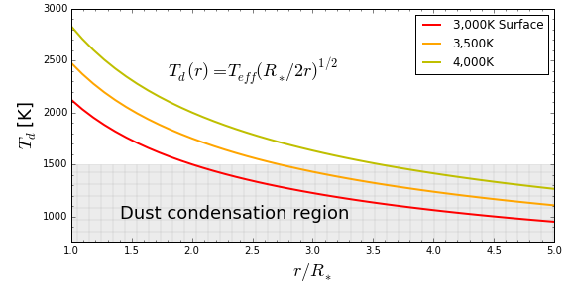
Dust-driven Winds
Radiation can only drive dust if dust has formed
Dust temp relation: Lamers & Cassinelli 1999
Dust condensation temp: Karovicova et al 2013
Notes:
While these stars may be ideal for MOVING dust, they can’t move any dust if none has formed yet.
Using the relationship for dust temperature from Lamers & Cassinelli 1999, I’ve plotted how the dust temperature changes at various distances from a star’s surface, for three temperatures.
We see that at MINIMUM, dust can only start to condense and form at distances of 2x the size of the star. For hotter stars, even further away.
Mid-way summary next

Slide 17
Dust-driven Winds
Dust-driven winds require the coolest stellar surfaces, plus something extra to push molecules away from surface
Require bright stars for light to drive dust
Prime candidates:
Pulsating Asymptotic Giant Branch (AGB) stars
Red Supergiant (RSG) stars
Notes:
Thus far we know that dust driven winds require the coolest stellar surfaces, plus something extra to push molecules away so they can condense into dust.
We also know that we need stars at least 1000 times brighter than our own Sun to drive the dust once it is formed.
Two prime candidates for this are pulsating AGB stars, and red supergiant stars.
AGB stars next.

Slide 18
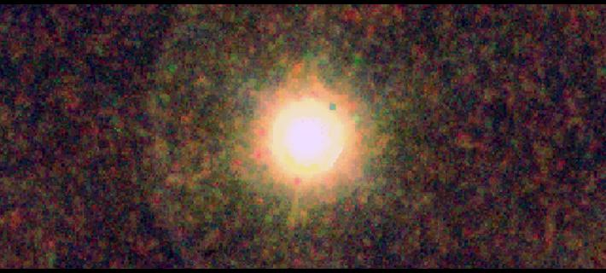
Dust-driven Winds:
AGB Stars
Characterized as enormous, bright, cool stars
R ~ 10²-10³ R⊙
T_{eff} ~ 3-4,000 K
L* > 10³ L⊙
Variability of L* due to short & long-term pulsations
The last stellar phase for stars with 0.8 < M* < 10 M⊙
Lasts about 10⁶ yrs (Iben & Renzini 1983)
Powered by…
Shell of helium (He) fusion around C/O core
Shell of hydrogen (H) fusion around He shell and C/O core
160µm
250µm
250µm
350µm
CW Leonis in FIR
Ladjal et al 2010
Notes:
AGB stars are characterized by being physically very large—roughly at least 100 times the size of our Sun. Their temperatures are between about 3 and 4 thousand K, and luminosities starting at 1000x brighter than the Sun. This brightness is not constant however; it varies on both timescales of hundreds of days, and thousands of years. I’ll go more into that later.
On the left side I have an image of the AGB star CW Leonis in the Far IR from Ladjal et al 2010. While the star itself is indistinguishable from any other bright spot, it does have a shell of dust around it that’s helping it shine in the infrared.
These stars shine due to two types of fusion going on in their interiors: He fusion into C/O, and H fusion around that helium shell.
Fusion next.

Slide 19
About Fusion…
Powers all stars, regardless of mass, temperature, size
Primary way for stars to keep their shape against gravity
Most common:
H-fusion into He (4 ¹H into ⁴He + energy)
He-fusion into C/O (3 ⁴He into ¹²C; ¹²C + ⁴He into ¹⁶O)
Heavier elements in high-mass stars
Notes:
Power from nuclear fusion is not exclusive to AGB stars. It powers stars of ALL types. It’s the primary way for stars to keep their shape against gravity.
The most common type of fusion processes are going to be your H fusion into He (two main ways for this to happen), and He fusion into carbon. In each chain, there’s energy created from the difference in mass and energy between the reactants (e.g. the H’s) and the products (He).
Ask me about my fusion chains!
Next is temperature dependence

Slide 20
About Fusion…
Energy generation sensitive to density, and highly sensitive to temperature in core: (Prialnik 2010)
~ρT⁴ for H-fusion by proton-proton chain
~ρT¹⁷ for H-fusion by carbon-nitrogen-oxygen cycle
~ρ²T⁴⁰ for He-fusion
E ~ T¹⁷
Energy Output
E ~ T⁴
Temperature (10⁷ K)
Adelberger et al 2010
Notes:
The energy generated from fusion is sensitive to density, and HEAVILY sensitive to the temperature where fusion is taking place. You NEED high densities and high temperatures in order for fusion to take place. However, as temperature increases the type of fusion you do will change.
At the lower temperatures, H fusion takes place via the proton-proton chain. Its byproduct is simply energy and helium.
At higher temperatures, H fusion via the CNO cycle takes place. Its byproducts are not only a ton of energy, but also C-13 and N-14
At even higher temperatures you cross the threshold beyond which you can fuse helium. Into C-12 and O-16.
Notice the exponents here. If you were to increase the temperature by 10%, you’d increase the energy output from the p-p chain by about 50%. That’s not bad.
For the CNO cycle, that power of 17 is going to increase your energy output by a 500%! That’s incredibly sensitive.
Even moreso, He fusion would increase output by 4,500%! This makes it incredibly unstable in low-mass stars, which we’ll discuss later.
Pulsations next

Slide 21
Dust-driven Winds:
Short-term AGB Pulsations
He⁺ ions become He⁺⁺
1
Less outgoing radiation
2
Radiation flows freely
1-3 yr
cycle
He layer cools
3
He⁺ ions
recombine
Notes:
I had mentioned that these AGB stars go through short and long-term pulsations. Let’s talk about the short term pulsations.
Energy created by the fusion processes in the AGB star interior will meet a layer of partially-ionized helium in its outer layers. Partially ionized because one electron has already been removed.
As radiation hits that layer, it’ll get absorbed as it ionizes that helium. The radiation pressure however was what was holding up the star against gravity. With less radiation going out, the star will contract.
Once all that helium gets ionized, radiation can again flow freely throughout the star, and it will expand again.
As the star expands, its outer layers cool. Cooler outer layers mean lower energy electrons and helium nuclei, that can now recombine and reform that partially-ionized layer. And so the cycle repeats.
Light curve next.

Slide 22
Dust-driven Winds:
Short-term AGB Pulsations
Variations in radius cause variations in brightness
Over period of ~1 yr T Ceph changes by factor of ~144 in L_{V}
T Cep over 16 Months from AAVSO;
Niyogi et al 2011
Notes:
This type of regular variability has been observed in AGB stars decades. The star will go through large changes in brightness, and the variability will always be around 1-3 years. This particular star changes its brightness by about a factor of 144 each period!
Dust cartoon next

Slide 23
Dust-driven Winds:
Short-term AGB Pulsations
Notes:
Pulsation is great and all, but how does it relate to dust-driven winds? Recall that in order to form dust, we needed our molecules to reside at large distances from our star. Pulsations allow for that to happen. When short-term pulsations occur, they thrust the star’s outer layers to larger distances, bringing with it a change in the density of gas at that distance.
When that gas gets to large enough distance, there it’ll be cool enough, will experience reduced gravity, and will have enough material around for that dust to form in a shell around the star. There will still be a space between the inner shell and the star’s surface, as it’s still too hot in that region to form dust.
Once the dust is formed, it can then share its momentum with the rest of the gas around it and drive that shell away from the star.
Sum up next.

Slide 24
Dust-driven Winds:
Short-term AGB Pulsations
Pulsations increase distance of molecules in AGB atmospheres from star
Increase density of material at large distances
Decrease effective gravity at molecule location
Decrease temperature at molecule location
Allows for dust formation and acceleration!
Lamers & Cassinelli 1999
Notes:
Just to recap that, pulsations increase molecule distance from the star. It also changes the density of gas in the outer layers, decreases the gravity at those distances, and eventually leads to a decrease in temperature at that new location. Thus dust can form.
Dust sources next.

Slide 25
Dust-driven Winds:
AGB Dust Sources
For 5 M⊙ star; R* = 44.1 R⊙ (Iben 1966):
C+O core: 0.035 R⊙
He-fusing shell: 0.035 — 0.04 R⊙
Inert He shell: 0.04 — 0.13 R⊙
H-fusing shell: 0.13 — 0.25 R⊙
H/He envelope: 0.25 — 44 R⊙
AGB stars are huge!
H/He envelope
H shell fusion
Inert He Shell
He shell fusion
C+O
Core
*Not the least bit to scale
Notes:
An important question is where are the atoms for this dust coming from? From deep within the interior of the star. Let’s take for example a 5 solar mass AGB star with a radius of 44.1 solar radii. I’ve depicted it to the left here, and it’s not at all to scale.
In the inner 0.035 solar radii, you have your carbon and oxygen-rich core. It’s not hot enough to fuse, it’s just there.
Next out we have the thin He-fusing shell.
After that, another thicker shell of helium without fusion. The fusing shell is so thin because again, He fusion is very sensitive to temperature and density. At this scale, the density and temperature of helium isn’t high enough to fuse.
Outside of that there’s a shell of hydrogen fusion, which is far more substantial in size.
Lastly, you have your enormous envelope of hydrogen and helium, which comprises the next 99% of the star’s physical size.
More dust sources next

Slide 26
Dust-driven Winds:
AGB Dust Sources
In addition to H and He fusion products (He, C, N, O), two more processes in AGB stars produce elements found in dusty winds:
α-process
Slow neutron capture (s-process)
Notes:
In addition to the fusion happening in those shells, creating He, C, N, and O, two more processes produce elements that are found in dusty winds
Alpha process next

Slide 27
Dust-driven Winds:
AGB Dust Sources
The α-process
¹³C
H
¹⁶O
n
H
N
N
e⁺
γ
¹⁴N
¹⁸F
¹⁸O
H
²²Ne
H
H
H
N
N
N
N
²²Ne
²⁵Mg
n
H
H
N
N
Notes:
The alpha process involves pumping up nuclei with helium nuclei (or alpha particles).
The first of two important reactions concerns C-13 generated from the CNO cycle of hydrogen fusion. When that fuses with a helium nucleus, it becomes O-16 plus a free neutron. This becomes important in a bit.
In a much longer chain, N-14 fuses with helium to make F-18. F-18 unstable so it’ll beta decay, becoming the next higher element O-18. O-18 fuses with helium to make neon 22, which fuses with another helium to make magnesium and a neutron. Again, these neutrons become important in the next slide.
S-process next.

Slide 28
Dust-driven Winds:
AGB Dust Sources
S-Process Nucleosynthesis
Herwig 2005
Stars with ⁵⁶Fe as a seed
Produce elements between 90 <(p⁺ + n⁰) < 204
Notes:
The slow neutron capture process (or s-process) is a major method of nucleosynthesis in AGB stars. You pump up a nucleus by bombarding it with neutrons. If the rate at which your neutrons hit these nuclei is slower than the the half lives of the nuclei, they’ll beta decay to the next highest element. Once they’re more stable, more neutrons will hit until they’re ready to decay again.
It all starts with Fe-56 as a seed, and produces a ton of elements with atomic masses between 90 and 204.
Convection next.

Slide 29
Dust-driven Winds:
Convection
Cold Exterior
R
Energy Source
Notes:
All of these nucleosynthesis processes are great, but they still need to get moved to the outer layers of the star. Enter: convection. Convection is a mode of energy transport that occurs when the energy source is putting out more energy than can be transported by light scattering off of atoms in in the gas.
Consider a bubble of hot gas whose energy content is high enough that the amount of energy it exchanges with its surrounding gas is small compared to the amount of energy it retains. It’ll be hotter and less dense than its surroundings, so it’ll float upward.
As it floats upward it’ll cool and expand, but still remain hotter than its surroundings and continue to rise.
Once that bubble reaches a certain height where it can share its energy with its surroundings, it starts to cool and contract.
As it cools and contracts it’ll sink. The energy it gains from its surroundings isn’t enough to bring it to the same temperature, so it’ll continue to sink until it reaches the bottom of the convective zone.
There it’ll heat up again, and the cycle continues.
• Has the effect of mixing not only energy from the inside out, but material from from great depths to higher layers
Schematic next.

Slide 30
Dust-driven Winds: Long-term AGB Pulsations
Unstable He-shell and H-shell fusion causes long-term (~10³ yr) pulsations of star
Convection in inert He-shell mixes materials outward
During He flare-up, convective envelope mixes materials to surface
Marigo et al 2013
Notes:
In AGB stars, convection mixes materials from the inner portions of the star toward its surface during long-term pulsations known as thermal pulses.
Hydrogen shell fusion dominates the energy production in an AGB star, but as it fuses it dumps helium onto the layers below it. While this is going on, convection mixes materials from the C/O core and helium fusion region outward. Once the temperature and density of the thin helium shell rise to the right values, helium fusion will ignite in a flash. During this period, the convective outer envelope will dip into the shell of material between the hydrogen fusing shell and the helium fusing shell.
Those s- and alpha processes occur in the layer between the hydrogen and helium fusing shells. So convection mixes those elements toward the surface.
And thus, you get your He, C, N, O, s-process, and alpha-process elements to the surface, ripe for making dust.
Putting it together next.

Slide 31
Dust-driven Winds: Putting it Together with Pulsations
Convection during long-term pulsations mixes materials from inner, element-rich layers to outer envelope
Short-term pulsations drive element-rich molecules to large distances from stars
Lower T_{d}, lower effective gravity, higher gas-density, and strong radiation fields allow dust to condense and accelerate
Notes:
Now to recap. Convection mixes materials from the interior outward during long-term pulsations.
Short term pulsations then drive element-rich molecules to large distances from the star’s surface
The lower dust temperature, effective gravity, higher gas-density, and high luminosity from the AGB star will allow dust to condense and accelerate, making the wind.
Observations next

Slide 32
Dust-driven Winds: Putting it Together with Pulsations
Radio Intensity
Ramstedt & Olofsson
2014
Wind Speed (km/s)
Notes:
We observe these winds is by looking at specific molecular lines. Here we have an observation of carbon monoxide in the AGB star IRAS15194. Carbon monoxide is readily made in AGB stars, and it emits intensely at radio wavelengths, so it can be used to characterize any AGB star with a dusty envelope.
Dust winds on AGB stars sum up next.
The width of this line indicates the velocity of the wind. This graph in particular is showing the wind speed relative to our location on Earth. Relative to the star itself, its wind speed is about 20 km/sec.

Slide 33
Dust-driven Winds: Putting it Together with Pulsations
Dust-driven winds relatively slow (10-50 km/sec) due to:
large dust formation distance
small escape velocity
dust needs many collisions with gas to carry it
Produce mass loss rates of between 10⁻⁷ and 10⁻³ M⊙ per year in AGB stars; remove several M⊙ during AGB lifetime
Ivezic & Elitzur 2010
Notes:
Observations of CO lines at various distances from the star tells us what velocity the wind reaches at large distances. It turns out that for AGB stars, the speeds of dust-driven winds are between 10 and 50 km/sec. The variation is due chiefly to the dust formation distance from the star, and the lower radiation field at that distance, the small escape velocity from the star, and the collisions that dust needs to make with the gas to carry it.
Even so, this slow wind removes several solar masses-worth of material from AGB stars over their lifetimes, with mass loss rates between 10⁻⁷ and 10⁻³ solar masses per year. These mass loss rates intensify as the star spends more time as an AGB star.
RSG stars next

Slide 34
Dust-driven Winds:
RSG Stars
Even more enormous and bright, cool stars
R ~ 10³-10⁴ R⊙
T_{eff} ~ 3-4,000 K
L* > 10⁴ L⊙
Minimally variable
The last stellar phase for stars with 10 < M* < 30 M⊙ (Maeder & Meynet 2008)
Lasts < 10⁶ yrs (Chiosi & Maeder 1986)
Powered by…
Shells of H and He fusion surrounding shells of fusion of higher elements
Betelgeuse; Kervella et al 2011
Notes:
AGB stars aren’t the only objects with dusty winds. Red supergiant stars are also cool enough and bright enough (even more so) to drive dust. On the right here we see a dusty envelope around the RSG Betelgeuse.
RSGs follow a significantly different track from AGBs, evolving from stars with initial masses between 10 and 30 times the mass of the Sun. Their lifetimes are typically less than a million years.
Not only are these stars powered by H and He fusion in their interiors, but they’ve also begun fusing higher elements as well. These elements show up in their winds.

Slide 35
Dust-driven Winds:
Differences with RSGs
RSGs show significant dusty stellar winds; weak, irregular variability. (Puls et al 2015)
Large-scale convection in RSGs create supersonic surface turbulence (Josselin & Plez 2007)
Simulated RSG; Chiavassa & Freitag 2014
Notes:
Unlike AGB stars, RSGs show weak, irregular variability. Not enough to push molecules out to the necessary distances for dust formation. Instead, massive convection cells create supersonic surface turbulence, accelerating molecules at the surface to large distances from the star and allowing dust to form.
RSG wrapup next
We have an example of such a star on the left here. Simulated red supergiant. Map of optical surface intensity (lighter = brighter). Bulging due to large convection cells. For comparison, the Sun is covered in millions of small convective cells, and on the whole still manages to remain fairly spherical.

Slide 36
Dust-driven Winds:
Differences with RSGs
RSG winds produce mass-loss rates between ~10⁻⁷-10⁻⁴ M⊙/yr
(Arroyo-Torres et al 2015)
Terminal wind velocities ~20-30 km/sec (Puls et al 2015)
Notes:
These convective cells still have the same constraints as the dust driven winds on AGB stars: luminosity, gas collisions, dust formation distances, and escape velocities from the star. As such, they have similar mass loss rates and terminal wind velocities.
Dust lines Recap

Slide 37
Dust-driven Winds: The Recap
Pulsations in AGBs drive molecules to large distances from star
Large-scale convection in RSGs does the same; convection in both mix materials from bowels to surface
Dust particles form in the extended environments of cool, giant stars
Dust then accelerated by radiative pressure
Collisions with gas drags gas with dust; sets terminal velocity to ~10-50 km/sec
Mass loss rates: 10⁻⁷ to 10⁻³ M⊙/yr
Notes:
To bring it all back together, pulsations in AGB stars drive molecules to large distances. Large scale convection in RSG stars does the same thing. Convection in BOTH types of stars allows for materials to mix from the bowels to the surface
Dust particles then form in the extended circumstellar environments of these cool, giant stars.
Once formed, dust is accelerated by radiative pressure, but is limited by collisions with the gas that it drags with it. Dust driven winds end up with terminal velocities between 10 and 50 km/sec
The mass loss rates from these stars end up being between about 10⁻⁷ and 10⁻³ solar masses per year
Start line-driven winds next

Slide 38
Line-driven Winds
Exclusively in hot stars; emission chiefly in UV
Transfer of momentum from photons to ions via atomic absorption
Momentum transfers from ions to gas through collisions
Not dust-driven due to high T_{eff} ( > 25,000 K)
Driven by elements with high opacity, e.g. C-IV, N-V, Si-IV, O-VI (Kudritzki 2000)
Notes:
Line driven winds occur exclusively in hot stars, where emission is chiefly in the UV.
Like dust-driven winds, there’s the transfer of momentum from photons to ions via absorption. That momentum then transfers from ions to the gas through collisions.
Too hot for dust to even try to form. However, the wind is driven by ions of high opacities; particularly C, N, Si, O, and Fe
Derivation next.

Slide 39
Line-driven Winds
Due to Doppler shift of atoms moving away from star at velocity v, can absorb photons between:
and
λ₀
C
Energy absorbed per sec by atoms:
Mass loss rate:
If absorbed line at peak of star emission:
Momentum transferred to gas per sec:
Finally, mass loss rate:
Lamers & Cassinelli 1999
Notes:
We can derive the mass loss rates for these winds here by considering one absorber and extrapolating to many. We start with one strong absorption line, noting that because of its velocity away from the star and the resulting Doppler shift, it can absorb radiation at a range of wavelengths.
The energy absorbed per second by the atoms is written here
Etc
Etc
Finally to the mass loss rate, which can be seen as being a function of the star’s total brightness since it’s absorbing at the peak of the star’s emission.

Slide 40
Line-driven Winds
•
M ≈ 0.6L*/c² per heavy-absorbing line
Typically have 10²⁻³ strong spectral lines in hot stars
Result:
hot main sequence stars lose ~30% of mass during lifetimes
Evolved hot stars lose another ~50% of remaining mass (Hillier 2000)
•
T = 50,000 K
Relative Flux
T = 30,000 K
Abbott 1982
Notes:
On the left we have model emission for two different stars, where each dark patch contains a blanket of strong absorption lines in the hot star’s outer atmosphere. It turns out that typically hot stars have between 10² and 10³ strong spectral lines. This results in enormous mass loss at all phases of massive star evolution.
Line sources next

Slide 41
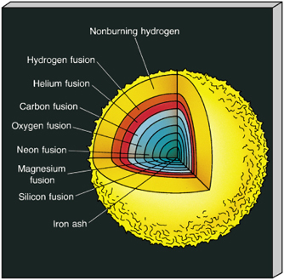
Line-driven Winds: Line Sources
Evolved high-mass stars have many-shelled interiors of fusion
High energy production in star core makes interior convective
Convection mixes materials from the center toward the surface (Eggenberger et al 2009)
Non-fusing H
H fusion
He fusion
C fusion
O fusion
Ne fusion
Mg fusion
Si fusion
Fe ash
Notes:
The strongest absorption lines come from C, N, O, and other elements actively being processed in the star’s interior. Because these are all actively undergoing fusion, and generating buckets of energy, the interiors of evolved massive stars are highly convective, and mix materials outward.
WR stars next.

Slide 42
Line-driven Winds: Wolf-Rayet (WR) stars
Brief stage of life before SN explosion for M* > 30 M⊙
Can evolve from BSGs, RSGs, or LBVs (Puls et al 2015)
Fusion still occurring feverishly in core & shells
Short lifetimes: 10⁵ yrs (Hillier 2000)
Very few observed (~500 in Milky Way)
WR 124; Mujires 2010
Notes:
Three types:
WN: strong N emission
WC: strong C emission; H-shell gone
WO: strong O emission; H-shell gone
Can evolve from blue supergiants, RSGs, or LBVs which I’ll talk about next. Fusion is still occurring feverishly in the star’s interior, but the star is rapidly nearing its end. Because large stars are already hard to come by and their lifetimes are short relative to low-mass stars, there have been very few observed thus far.
LBVs next

Slide 43
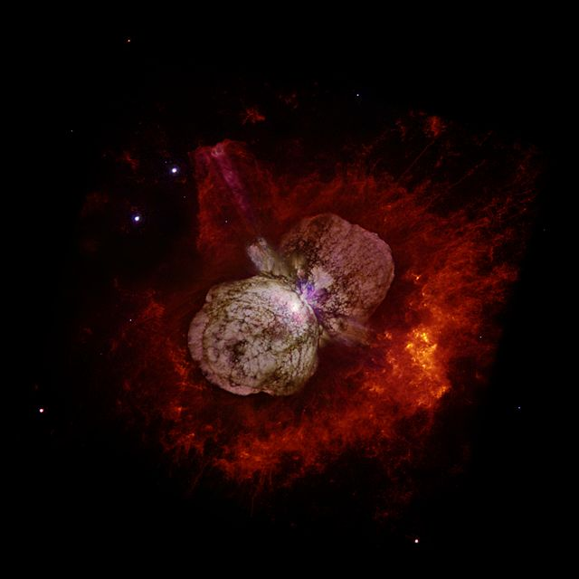
Line-driven Winds: Luminous Blue Variables (LBVs)
Brief stage of life before SN explosion
Final stage of the most massive stars (M* > 50 M⊙; Chiosi & Maeder 1986)
Most of radiation in UV
Episodic periods of extremely-high mass loss (0.1-0.5 M⊙/yr; Puls et al 2015)
LBV binary Eta Carinae
Hubble Space Telescope
Notes:
Similarly, luminous blue variables are also brief stages of life before SN explosions. The very most massive stars become LBVs, and most of their radiation comes out in the ultra violet. When these stars are operating normally, they do experience average line driven winds. However, it seems that periodically they go through extremely-high mass loss, on the order of 10-50% of a solar mass per year for decades.
More on LBVs next.

Slide 44
Line-driven Winds: Luminous Blue Variables (LBVs)
Episodic mass loss periods still not well constrained
Unclear on physical processes or even frequency
Suspects:
Super-Eddington winds
Supernova-like explosions (Smith 2014)
Notes:
Episodic outbursts are not well constrained. Observations have included winds powered by luminosities that are so high that the star should be torn apart by its own radiation. The mechanism for these huge, irregular variability is as yet unknown.
P Cygni profiles next.
The Eddington limit is the maximum amount of radiation a star can produce while still holding itself together against gravity. Irregularly, LBVs have shown super-eddington radiation, but haven’t lost form. May have to do with clumping of gas/dust in the circumstellar envelope.
LBVs like Eta Carinae have also shown winds that appear to be heated like in supernova explosions. However, no mechanism has yet been found to explain these outbursts that don’t destroy the star.

Slide 45
Line-driven Winds: P Cygni Profiles
v
Blue-shifted emission
Mass loss envelope
λ₀
Blue-shifted absorption
v
Line of sight
λ₀
λ₀
Observer
Red-shifted emission
v
photon wavelength λ₀
λ₀
Regular emission
From star
P Cygni profile!
Intensity
Intensity
Wavelength
Wavelength
Le-Mujires 2010
Notes:
These winds can and have been measured, using the emission and absorption features of strong lines in stars along with knowledge of Doppler shift. Consider looking at a hot evolved star. If it didn’t have a strong wind, its emission would simply appear normal.
However, with a with a wind we see the effects of absorbers in the wind. Along the line of sight, we have atomic absorption by particles moving toward us, so that absorption is blue-shifted from its fundamental value.
Out of the line of sight, there are observes in the wind that will emit in our direction. When they emit while moving toward us, their emission is blue shifted. While moving away, their emission is redshifted.
The result is what’s known as a P Cygni profile.
P Cygni profile data next

Slide 46
Line-driven Winds: P Cygni Profiles
Observed regularly in hot stars of all stages of evolution
Can be observed in ionized UV lines, or in Hα lines
V∞ ~ 3,400 km/sec
Intensity
Wavelength (Å)
C-IV doublet (1548Å, 1550Å)
O3-star Sk-68°137
Kudritzki & Puls 2000
Notes:
P Cygni profiles are observed regularly in hot stars of all stages of evolution. It can be observed in ionized UV lines or in H-alpha lines at optical wavelengths.
On the left we have a prime example of a strong P-Cygni profile from the C-IV doublet at 1548 and 1550 angstroms. This emission is from a hot O3 star, and the profile features are fit with a models that average to wind speeds of 3,400 km /sec
Terminal velocity next

Slide 47
Line-driven Winds Terminal Velocity
Terminal Velocity V∞ limited by
Escape Velocity
Number of optically thick (strong) lines
vs thin (weak) lines
The reduction in v_{esc} due to
L* and electron scattering
The relationship
Lamers & Cassinelli 1999
Notes:
That terminal velocity is high, but not without limits. We consider gravity from the star, the reduction in gravity due to light scattering off of electrons in the atmosphere, and the presence of strong lines relative to weak ones.
The terminal velocity is limited by the escape velocity, which is why it scales with gravity

Slide 48
Line-driven Winds
Radiation pressure drives winds to 1-4,000 km/sec (~1% light speed)
Metal enrichment of stellar atmosphere increases wind efficiency (more Fe, better wind; Lamers & Cassinelli 1999)
LBVs slightly slower (600 km/sec; Smith 2014)
Kudritzki & Puls 2000
Notes:
Measurements from P-Cygni profiles show range of line-driven wind velocities.
Some of the scatter observed is due to large differences in metallicities, changing wind efficiency.
Slower wind speeds for LBVs goes back to the definition for the terminal velocity. It’s proportional to the escape velocity from the star,. If the star has a lower escape velocity, then the wind that escapes will be slower
Surface chemistry next.

Slide 49
Line-driven Winds: Surface Chemistry
Winds of hot stars rapidly carry away outermost layers of stars
Change surface abundance as mass diminishes
⁴He
¹H
Surface Abundance
¹²C
Remaining Mass
Chiosi & Maeder 1986
Notes:
These winds drastically change the abundances of elements at the surfaces of these stars. Let’s start with H. H comprises the bulk of the star’s envelope, so it’s also the first to get dragged off with radiatively-driven ions. Eventually enough has gone to effectively have removed H completely from the star.
The next shell inward is He. As such, as that hydrogen envelope gets lost, helium appears at higher and higher abundances, until that helium shell is at the surface. At that point, its abundance begins to drop from wind acceleration.
Lastly we have carbon 12, the direct product of He fusion. Its surface abundance decreases as whatever was in the envelope gets lost, but then shoots up as C12 starts to appear with the helium layer.
Summary next

Slide 50
Line-driven Winds: Summary
Gas in star’s outer atmosphere driven by the transfer of momentum from radiation
Momentum transfers through atomic absorption
Absorbing atoms drag surrounding gas through particle-particle interactions
Bulk movement of gas causes larger mass loss in hotter, more massive stars
Notes:
Just follow the text.
Full summary next.

Slide 51
The Winds Wrap Up
Stellar winds in late stages of stellar evolution dramatically affect host stars and surrounding ISM
Convection mixes products of nucleosynthesis from star interiors to outer atmospheres
AGB stars use short-term pulsations for creation of dusty winds driven by radiation
RSG stars use convection to condense and radiation pressure to accelerate their dusty winds
WRs and LBVs accelerate ions via atomic absorption to create line-driven winds
Notes:
Another summary.
My work next.

Slide 52
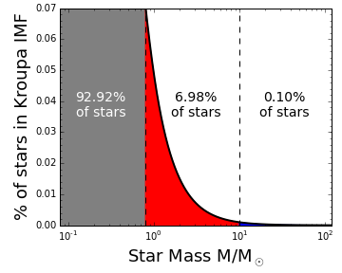
Relation to My Work
AGB Stars Probing the Structure and Evolution of the Milky Way
AGB phase is last stellar phase for all stars with 0.8 < M* < 10 M⊙
If identified, should be seen nearly everywhere in Galaxy, even to far side
IMF from Kroupa 2001
Notes:
Explain an what an initial mass function does and how it’s relevant here.
IR observability next

Slide 53
Relation to My Work
C-rich and O-rich AGB star emission in the IR (Ishihara et al 2011)
Intensity
Wavelength (µm)
Notes:
The shaded regions in the background are the bandpasses for Spitzer. The highlight should be the dotted curves, which show the emissivity of carbon-rich and oxygen-rich AGB stars in the MIR.

Slide 54
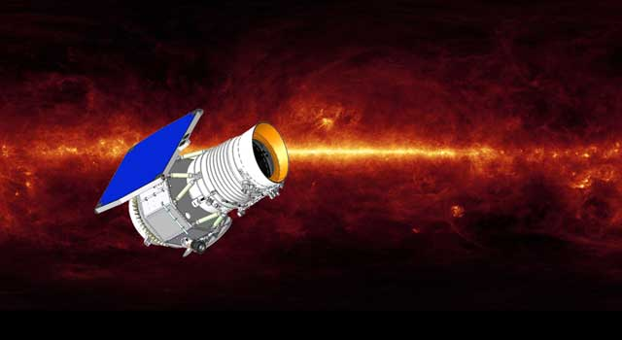
Relation to My Work
Enter: the Wide-field Infrared Survey Explorer (WISE)
Year-long survey of the full sky
Unprecedented NIR/MIR sensitivity
Catalog of 750+ million objects
Credit: http://www.jpl.nasa.gov/wise/overview.cfm
Notes:
WISE is awesome. Just basic info

Slide 55
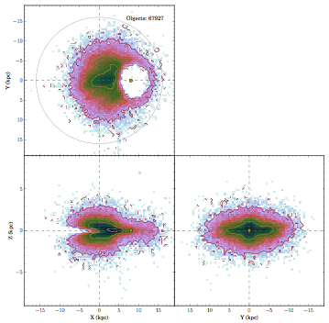
Relation to My Work
Identified ~68,000 AGB candidates in the Milky Way with WISE
Vertical and radial extent of the disk
Can be used to verify models of Galactic structure
Hunt-Walker et al. in prep
Y
The Sun
Z
X (kpc)
Y (kpc)
Notes:
Just ad-lib it

Slide 56
Relation to My Work
Matches of AGB candidates to SDSS APOGEE Red Giant Survey
Measurements of metallicity in SDSS combined with measurements from AGB candidate sample = 3D metallicity map of the Galaxy
Galactic Latitude
Galactic Longitude (deg)
Hunt-Walker et al. in prep
Notes:
Make sure you mention APOGEE. It has about 163,000 objects with measurements of metallicity.

Slide 57
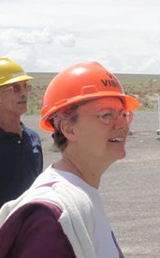



Acknowledgments
My Committee
Mario Juric
Antonino Ferrante
Zeljko Ivezic
(chair)
Suzanne L. Hawley

Slide 58




Acknowledgments
Grad students (current and former)
Folks with Feedback
Textbooks, papers, sanity checks, general inspiration, motivation, reassurance
Dre Dunlap
Eddie Schwieterman
Cliff Johnson
Diana Windemuth
Russell Deitrick
Phil Rosenfield
Jim Davenport
Nell Byler
Phoebe Sanderbeck
Ismael Simekha
Rhoan Garnett
Alma Khasawnih
José Hernandez

Slide 59



Acknowledgments
Family and Friends

Slide 60




Acknowledgments
The Lady

Slide 61


Slide 62
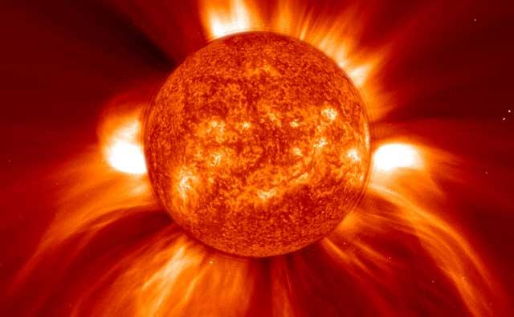
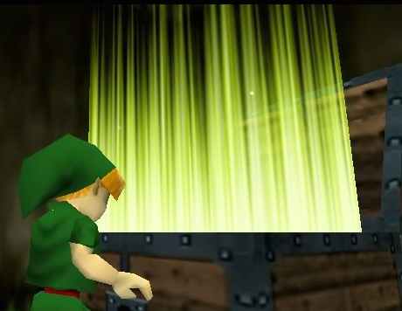
BONUS
SLIIIIIIDES

Slide 63

Conflicting views on Stellar Winds

Slide 64
Powering Stars: H-fusion
Proton-proton Chain (simplified)
e⁺
Deuterium
γ
H
H
Helium - 3
N
H
H
H
N
Helium - 4
H
H
H
H
e⁺
N
N
H
H
H
N
H
H
H
N
H
γ
Notes:
Proton chain step by step:
Hydrogen
Deuterium + positron emission (energy)
Helium 3 (energy)
Helium 4

Slide 65
Powering Stars: H-fusion
CNO Cycle (simplified)
γ
H
H
¹⁴N
γ
¹³C
¹⁵O
e⁺
e⁺
¹³N
¹⁵N
γ
¹²C
H
H
H
H
⁴He
N
N
Notes:
Stars need to at least have some carbon to start this
Carbon plus hydrogen = nitrogen plus energy
Nitrogen beta decays to carbon
Carbon plus hydrogen = stable nitrogen
Nitrogen plus hydrogen = oxygen plus energy
Oxygen beta decays to nitrogen
Nitrogen plus hydrogen = Carbon plus helium; cycle restart

Slide 66
Powering Stars: He-fusion
Triple-α Fusion (simplified)
very
unstable
τ ~ 10⁻¹⁶ s
H
H
N
N
H
H
N
N
⁴He
⁸Be
¹²C
H
H
N
N
γ
γ

Slide 67
Dust-driven Winds
Like gas in line-driven winds, dust grains can also be driven by photon absorption
Absorption not just from specific lines
Radiation pressure must > gravity
However…
Opacity of dust: κ_{d} ≈ 10 cm² / g (carbon)
5 cm² / g (oxide)
Radiation Pressure force:
Force of Gravity:
For oxide dust:
For carbon dust:
Typical M_{AGB}: 1-9 M⊙
Typical L_{AGB}: > 10³ L⊙
10³ >>>>> 150 or 300
✔

Slide 68
Dust-driven Winds
Radiation can only drive dust if dust has formed
At star surface, T_{eff} ≈ 3000 K
Oxide/carbon dust sublimates at 1200-1500 K
Dust can’t form at surface!
Energy absorbed by dust grain per second:
Energy emitted by dust grain per second:
And so…

Slide 69
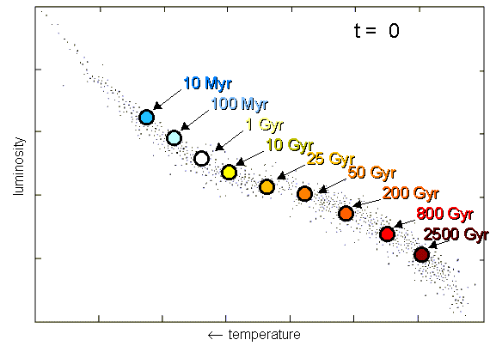
The Main Sequence
*1 Gyr = 1 billion years
Credit: http://astro.berkeley.edu/~dperley/univage/univage.html
Notes:
Massive stars live shorter lives than less massive stars, illustrated here. This is chiefly because they have more mass. More mass = more gravity. More gravity = more energy needed to stave off collapse. Higher energy production means more hydrogen consumption in the core, shortening the main sequence life span.

Slide 70
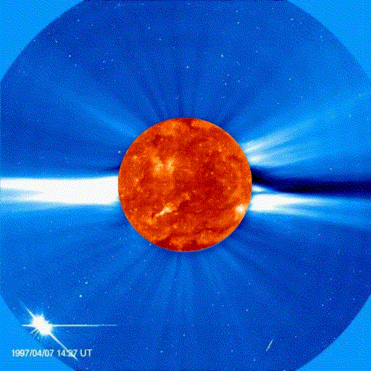
The Sun’s Coronal Wind
Note: not occurring in a late stage of evolution
Driven by gas pressure, thermal conduction in the corona, and Sun’s magnetic fields
At large distances from the Sun, hot coronal plasma can escape
Responsible for loss of 10⁻¹⁴M⊙ yr⁻¹ (very low rate); reduces Sun’s mass by 0.01% over life
Credit: http://solarscience.msfc.nasa.gov/CMEs.shtml

Slide 71
The Main Sequence
P-P Chain II (simp.)
H
H
e⁻
N
N
H
H
N
N
⁷Be
⁷Li
H
H
N
N
H
H
N
H
γ

Slide 72
The Main Sequence
P-P Chain III (simp.)
H
H
H
e⁺
N
N
H
H
N
N
⁷Be
⁸B
⁸Be
H
H
N
N
H
H
N
γ

Slide 73
High-mass Star Evolution: LBVs
Another brief stage of life before SN explosion
“Luminous Blue Variable”
Final stage of the most massive stars
Most of radiation in UV
Extremely high mass loss (more on that later)
LBV binary Eta Carinae
Hubble Space Telescope

Slide 74
Low/Intermediate-mass Star Evolution
*A Note About Very Low-Mass Stars
M < 0.8 M⊙ fuse H on the Main Sequence but are not massive enough to fuse He
Main sequence lifetimes exceed age of galaxy and universe; no actual post-MS products have been observed

Slide 75
High-mass Star Evolution: Mass Matters
All stars with M* > 10 M⊙ end as supernovae (SNe)
If M* < 25 M⊙, life ends as red supergiant (RSG) after fusing to Fe before SN
If 25 < M* < 50 M⊙, life ends as Wolf-Rayet star (WR) before SN
If M* > 50 M⊙, they don’t make it to RSG phase; become Luminous Blue Variables during He-shell fusion, lose atmosphere, then WR to SN

Slide 76
The Main Sequence
CNO Cycle II (simplified)
H
H
⁴He
Low probability
N
N
H
H
¹⁴N
γ
¹⁷O
¹⁵O
e⁺
e⁺
¹⁷F
¹⁵N
γ
¹⁶O
H
H
γ

Slide 77
Line-driven Winds
P Cygni profiles tell-tale signs of line-driven wind
Observed regularly in hot stars of all stages of evolution
Mujires 2010
Intensity
Wavelength

Slide 78

Relation to My Work
Hunt-Walker et al. in prep
Measurements of vertical and radial extent of the disk
Verification of existing models of Milky Way disk structure

